Slide 1

Artificial Intelligence for Business Decisions and Transformation
CSCN8030 - Spring 2024 - Section 2
Sprint 2 - Design
10 June 2024
Group 4 - Members:
Krishna Kumar, Hemasree
Shijin, Jency
Fernandez, Arcadio
Professor:
Glaucia Melo dos Santos, PhD

Slide 2

ML-Driven Customer Segmentation for Brazilian eCommerce

Slide 3
Agenda
1. Group members role
2. Dataset and benchmark codes
3. Project Pitch
4. Sprint Planning
5. Reference

Slide 4


1. Group members role
Product owner
Developers
Hema
Arcadio
Jency
Connects with the customer
Contributes to the vision and roadmap
Manages and prioritizes the team backlog
Supports the team in delivering value
Continuously evolves product design
Implements the vision and roadmap
Works on the team backlog
Builds, tests, and delivers increments of value

Slide 5
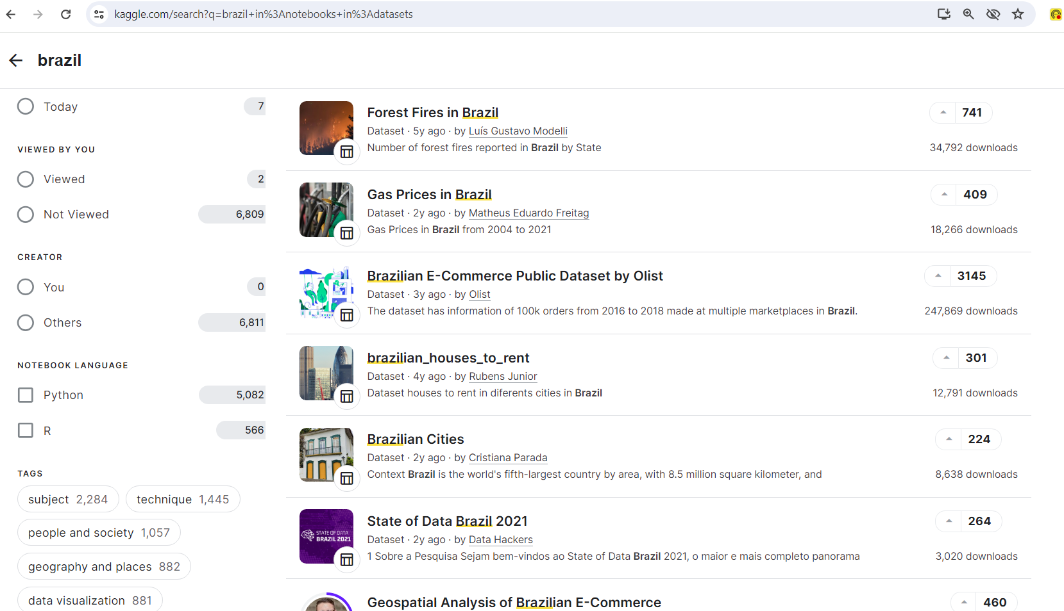
2. Dataset and benchmark codes
https://www.kaggle.com/datasets/olistbr/brazilian-ecommerce

Slide 6
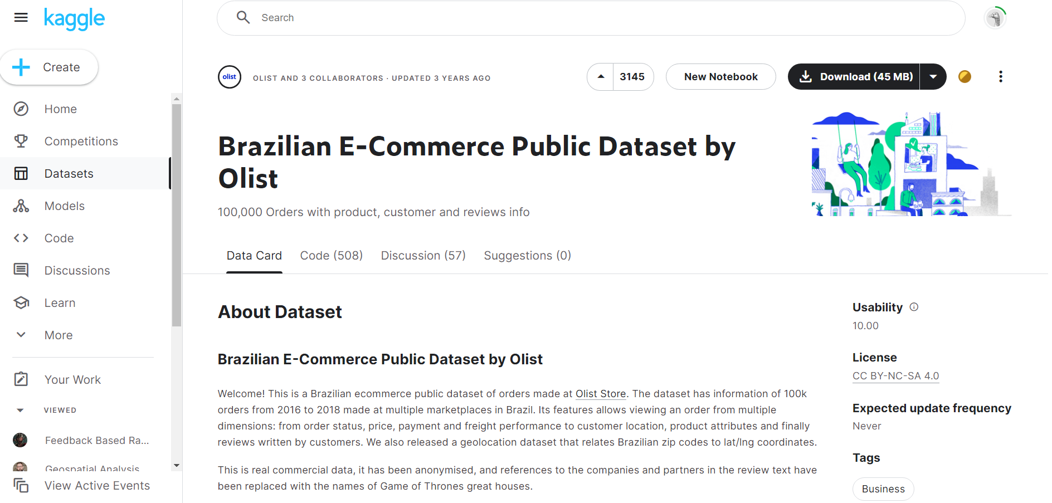
2. Dataset and benchmark codes
https://www.kaggle.com/datasets/olistbr/brazilian-ecommerce

Slide 7
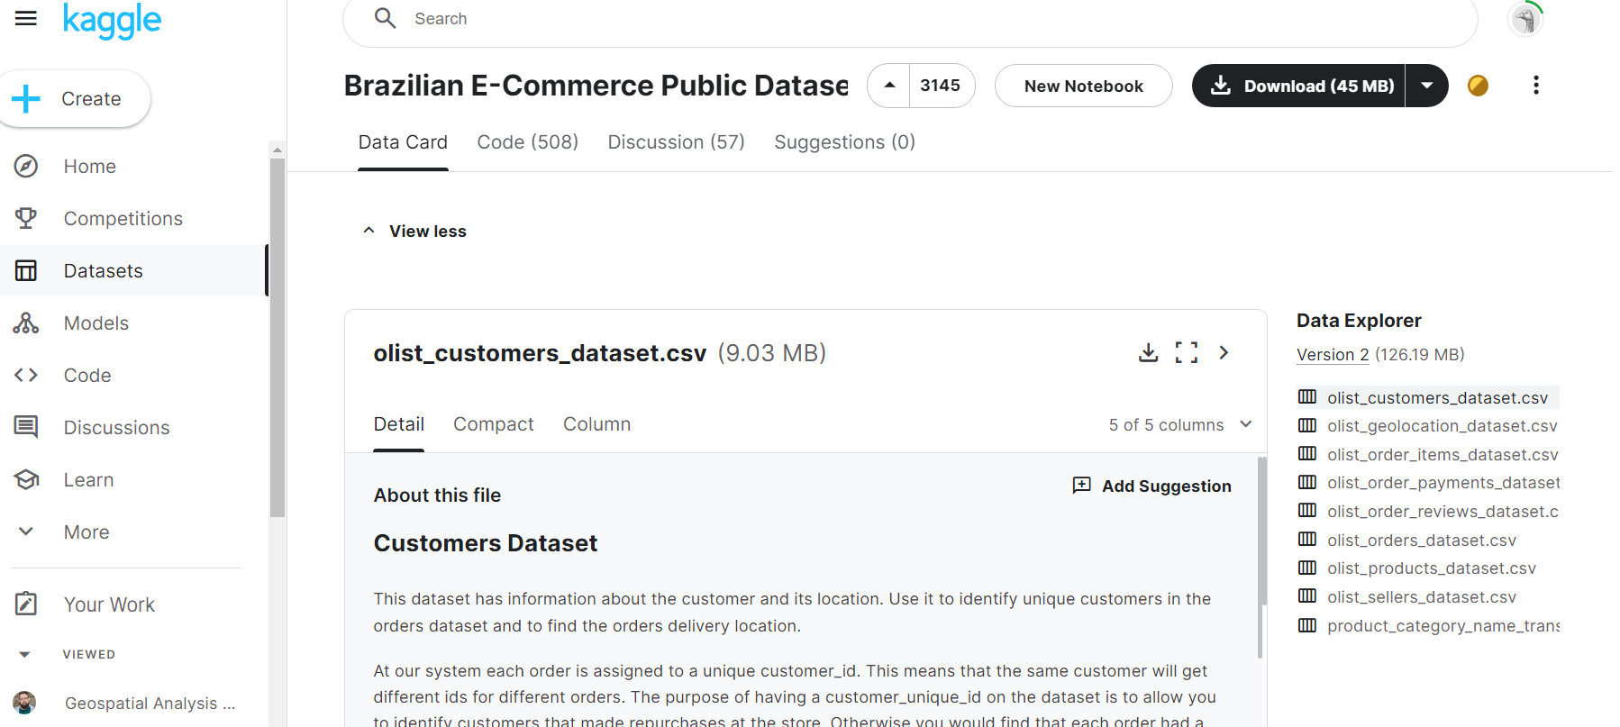
2. Dataset and benchmark codes
https://www.kaggle.com/datasets/olistbr/brazilian-ecommerce

Slide 8
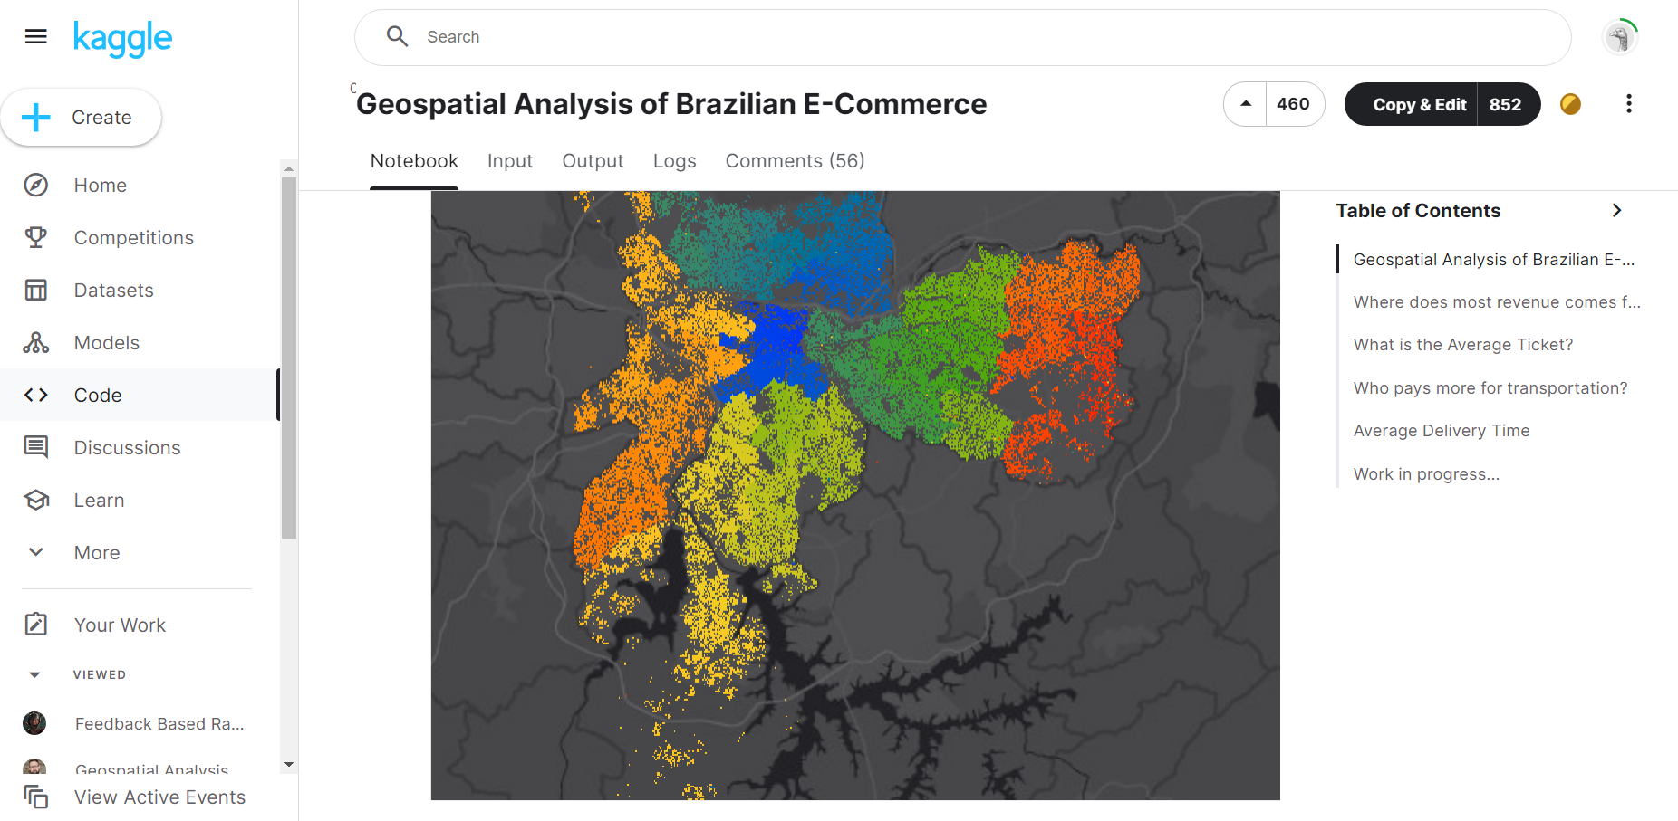
2. Dataset and benchmark codes
https://www.kaggle.com/code/andresionek/geospatial-analysis-of-brazilian-e-commerce

Slide 9
3. Project Pitch
Project Pitch | BUSINESS
Organization or Category | Olist - eSales Plataform
Description of Organization | Olist plays an important role in the e-commerce ecosystem by addressing the gap between the small and medium sized retailers and large online marketplaces. Its extensive suite of services, from marketplace integration, logistics, marketing support, to financial leveraging, empowers the retailers to grow their reach, streamline their operations, and become more productive in their business. This will not only benefit the retailers but will also enhance the shopping experience for customers and further contributes to the growth of the e-commerce sector.
Two Specific Ethical Considerations in AI Adoption | User Data Privacy: Ensure that any personally identifiable information (PII) is anonymized to protect the privacy of individuals. Data should be used in a way that does not reveal individual identities. Compliance with Laws: Adhere to data protection laws and regulations such as the General Data Protection Regulation (GDPR) in the EU, and Brazil’s LGPD. Also ensure all data processing activities are compliant with these regulations.

Slide 10
3. Project Pitch
Three Examples of Operational Decisions | 1. Product Management: Identify the most popular products in each segment and focus on expanding these lines or introducing similar products. 2. Personalized Recommendations: Use customer purchase history and preferences to offer more personalized product recommendations, thereby increasing the likelihood of repeat purchases. 3. Prioritized Support: Offer prioritized customer support to high-value segments or those with frequent purchases to enhance customer satisfaction.
Three Examples of Tactical Decisions | 1. Promotional Campaigns Plan and execute promotional campaigns during peak sales periods to maximize the sales. Offer discounts on popular products to boost sales volume. 2. Pricing Strategy Implement dynamic pricing strategies to remain competitive in the market while also maximizing profit margins. Use price elasticity analysis to adjust the product prices based on market demand. 3. Customer Retention Programs Develop customer loyalty programs, targeted follow-up communications to encourage repeat purchases etc
Three Examples of Strategic Decisions | 1 . Market Expansion Focus the marketing efforts in regions with high demand and also consider entering new geographical markets with similar demographic profiles. 2. Customer Segmentation and Targeting Develop targeted marketing campaigns for different customer segments to improve the customer acquisition and retention. Tailor promotions and offers based on customer segments. 3. Customer Service Enhancement Invest in improving customer service processes, such as faster response times and better handling of returns and refunds. Use sentiment analysis to identify and address negative feedback proactively.

Slide 11
3. Project Pitch
Why this is topic important? | This topic is important because effective customer segmentation is crucial for businesses to understand and cater to the needs and preferences of their customer base. According to a report by McKinsey, companies that use customer segmentation strategies see an overall 10% increase in customer satisfaction and a 2-5% increase in revenue.
How could this project make an impact outside of class? | Customer segmentation enables precise and scalable analysis of vast customer data. ML algorithms, like K-Means clustering or hierarchical clustering, can discover patterns and insights that traditional methods might miss. Understanding these patterns will lead to increased sales, improved customer satisfaction, and streamlined processes.
Why should class choose this topic? | This project offers a practical application of data analysis and machine learning techniques in a real-world context. By working with a rich dataset from the Brazilian eCommerce industry, we can gain hands-on experience in customer segmentation, which is a crucial aspect of marketing and business strategy. Also, businesses can gain actionable insights that help drive their future marketing campaigns, optimize inventory management, and enhance customer experiences.

Slide 12
4. Sprint Planning
Tasks | Owner | Priority | Sprint | Story Points | Estimated Effort in Hours
Perform Data integration by merging customer data, orders data, product data, and any other relevant information by identifying common keys or fields. | Jency | med | 1 | 3 | 1
Clean the data by handling missing values, correcting data types, and ensuring data consistency. | Jency | med | 1 | 3 | 1
Explore the dataset to understand its structure, features, and distributions to gain insights into customer demographics, purchase behavior, and order details which is relevant for segmentation. | Jency | high | 1 | 5 | 1
Create new features such as calculating RFM (Recency, Frequency, Monetary) scores, deriving customer lifetime value (CLV), and extracting geographical features or transform existing ones to facilitate segmentation. | Arcadio | high | 1 | 5 | 2
Encode categorical variables into numerical format using techniques like one-hot encoding or label encoding. | Arcadio | med | 1 | 3 | 1
Scale numerical features to ensure they have similar ranges, which can improve the performance of ML algorithm. | Arcadio | med | 1 | 3 | 1
Choose appropriate clustering algorithms based on business objectives | Hema | med | 1 | 3 | 1
Implement chosen clustering algorithms on the preprocessed and integrated dataset. | Hema | high | 1 | 5 | 2
Experiment with different numbers of clusters to find the optimal segmentation solution. | Hema | med | 1 | 3 | 3
Assess the quality of segmentation using appropriate metrics | Jency | high | 1 | 5 | 3
Profile each segment by analyzing key metrics and characteristics, such as average purchase frequency, total spending, geographic distribution, and product preferences. | Hema | high | 1 | 5 | 2
Interpret the segmentation results to understand the underlying customer behavior and preferences. | Arcadio | high | 1 | 3 | 3

Slide 13
4. References
1. Brazilian e-commerce data analysis. (n.d.). https://www.kaggle.com/code/paritoshmahto/brazilian-e-commerce-data-analysis
2. Ceruttivini. (2022, May 25). RFM segmentation and customer analysis.
https://www.kaggle.com/code/ceruttivini/rfm-segmentation-and-customer-analysis
3. Richardnnamdi. (2019, October 28). Customer Segmentation & LTV.
https://www.kaggle.com/code/richardnnamdi/customer-segmentation-ltv

Slide 14
Thank you

